Slide 1

SBA USASPENDING ANALYTICS WEBSITE STORYBOARD THE SBA HELPED CREATE OVER 149,719 JOBS IN AMERICA FROM 2005-2015 THROUGH ITS COUNSELING CENTER PARTNERSHIPS

Slide 2
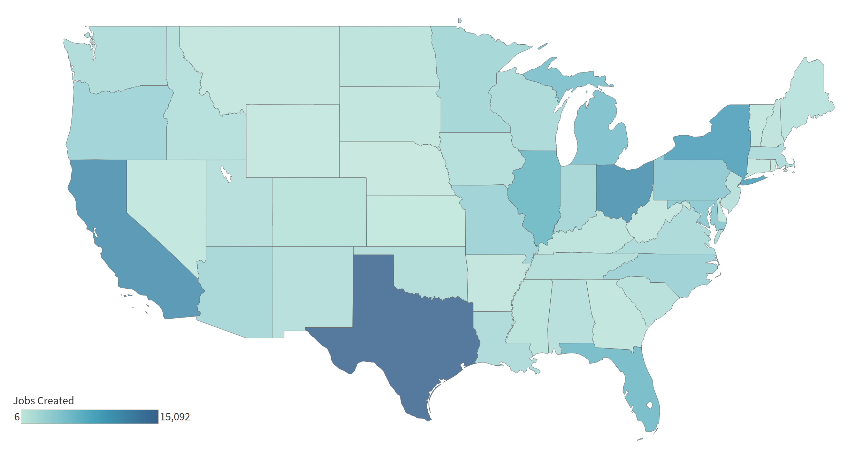
Between 2005 and 2015, businesses which received training and/or counseling support from the SBA created 149,719 Jobs
SBA provides loan assistance and grants to individuals and small businesses for promoting job creation in the United States.
Services provided through the Small Business Development Centers (SBDC) and Service Corp of Retired Executives (SCORE) which are located in states across the country
Businesses which received counseling or training support from the SBA between 2005 and 2015 went on to create over 149,719 jobs within that same time span. The figure to the right shows the geographic spread of this job creation
The Federal government provided ~$918M in grant assistance through these two SBA partnerships. Therefore, these businesses were able to create 1 job per $7,420 provided through SBA grants.

Slide 3
To conduct this analysis, we matched internal SBA counseling/training data with publicly available spending data found on USAspending.gov
Between 2005 and 2015, ~3.3M businesses received counseling or training support through SBDC or SCORE
When these businesses receive support, they report their total employees
When businesses receive support on more than one occasion, the SBA is able to track the change in the companies size based on the employees reported.
Of these, ~360K visited the same center in more than one year, which enables the SBA to estimate job growth based upon the number of reported employees at the businesses these clients represent.
Between 2005 to 2015, the SBA allocated $1.6M in grant funding for various programs
Of this, $918M went towards funding for SBDC and SCORE program. Therefore, ~16.2 jobs were created by businesses who received counseling or training support from the SBA per $100K of grant awards.
In some instances, there were businesses who reported growth that suggests potential data quality anomalies. For example, one business reported 25,000 employees in 2009 and just 1 employee in 2010.
To addresses these outlier cases, we remove the top half percent (0.5%) of the data based on absolute change in rate of employment.

Slide 4
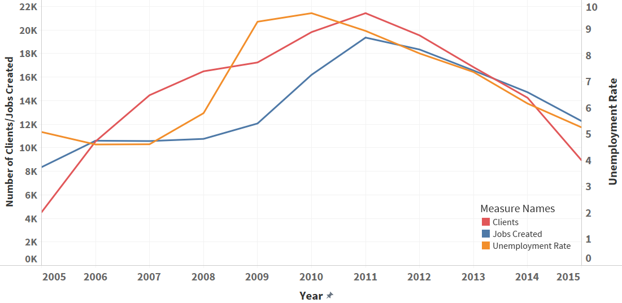
Initial Finding demonstrates that client visits and subsequent job creation Correlates with overall economic Trends
This chart depicts trends over time for:
Number of Client Visits (Red)
Number of Jobs Created by those Clients (Blue)
National Unemployment Rate (Orange)
As unemployment rates increased during the recession, more clients visited the SBA and as a result, created more jobs in the following years.
While causality cannot be determined, this suggest that jobs created by SBA businesses do help do help drive down unemployment across the country.

Slide 5
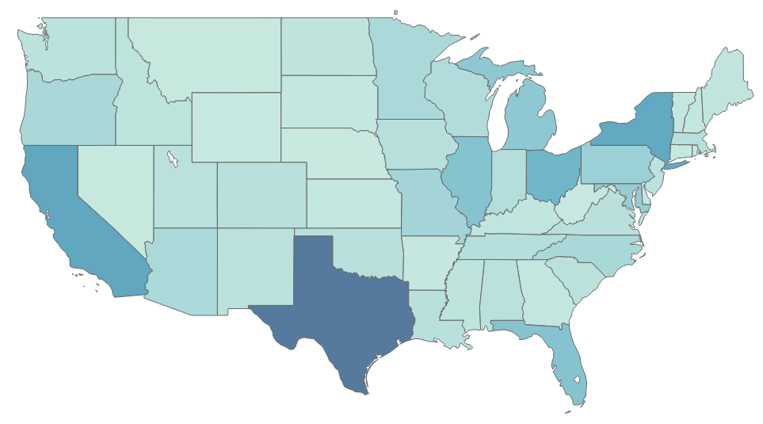
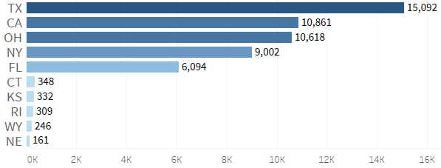

The Top and bottom five states show a diverse geographic footprint
Top 5 and Bottom 5 States by Job Creation

Slide 6
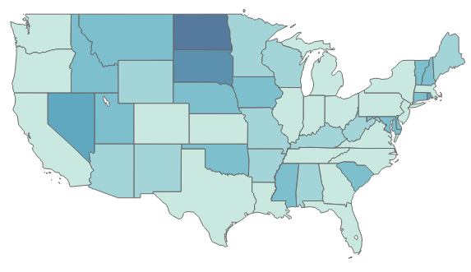
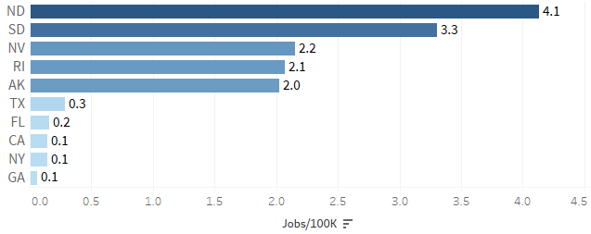

Looking at jobs created per grant dollar award may highlight states where grant dollars are yielding a greater return on investment
Top 5 and Bottom 5 States by Job Creation per $100K

Slide 7
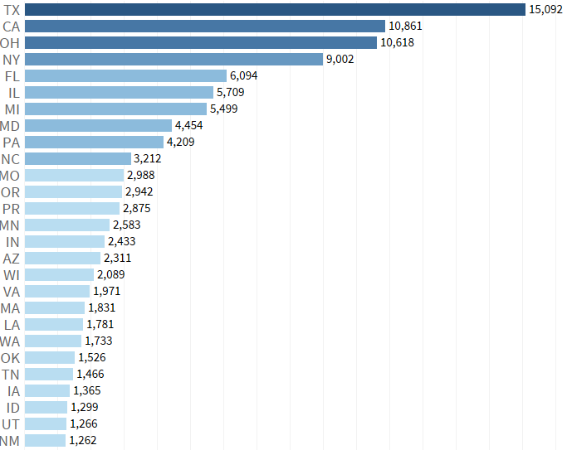

Appendix – Job creation ranking by state

Slide 8
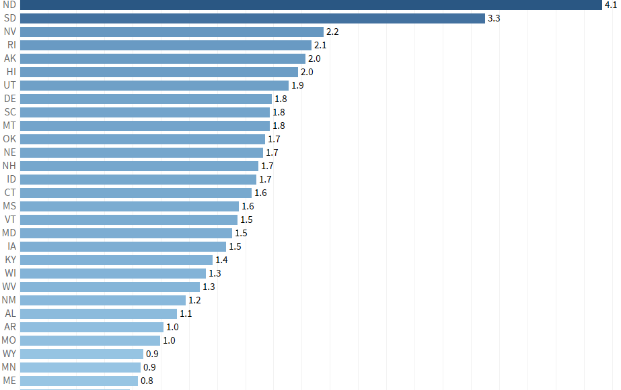
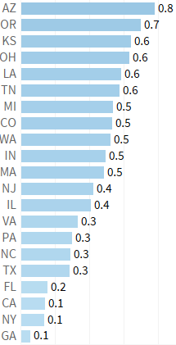
Appendix – Job creation per 100K per state

